Slide 1








https://twitter.com/appclubim https://www.youtube.com/user/appclubim
https://www.facebook.com/appclub.im/ http://www.meetup.com/AppClub/

Slide 2
How to make your website optimized, fast and secured
Oleksandr Krakovetskyi
CEO DevRain Solutions
PhD, Microsoft RD/MVP

Slide 3
Agenda
SEO.
Mobile websites and Google.
Performance.
Social networks integration.
Security.
Premier league ☺
Semantic web & scheme.org
Microformats
Accessibility

Slide 4
SEO
HTTP codes (301, 302, 404, 503) HTTP 451 Unavailable For Legal Reasons (approved by the IESG on December 18, 2015).
Robots.txt / Sitemap.xml
Last-Modified header (304 Not Modified). Check here: http://last-modified.com/ru/if-modified-since.html
Geotags http://ru.mygeoposition.com/

Slide 5
Multiple languages
https://support.google.com/webmasters/answer/189077?hl=en
<link rel="alternate" href="http://example.com/en-ie" hreflang="en-ie" />
<link rel="alternate" href="http://example.com/en-ca" hreflang="en-ca" />
<link rel="alternate" href="http://example.com/en-au" hreflang="en-au" />
<link rel="alternate" href="http://example.com/en" hreflang="en" />
For language/country selectors or auto-redirecting homepages, you should add an annotation for the hreflang value "x-default" as well:
<link rel="alternate" href="http://example.com/" hreflang="x-default" />

Slide 6
Paging
https://support.google.com/webmasters/answer/1663744?hl=en
Let's say you have content paginated into the following URLs:
http://www.example.com/article-part1.html
http://www.example.com/article-part2.html
http://www.example.com/article-part3.html
http://www.example.com/article-part4.html
In the <head> section: <link rel="prev" href="http://www.example.com/article-part1.html">
<link rel="next" href="http://www.example.com/article-part3.html">

Slide 7
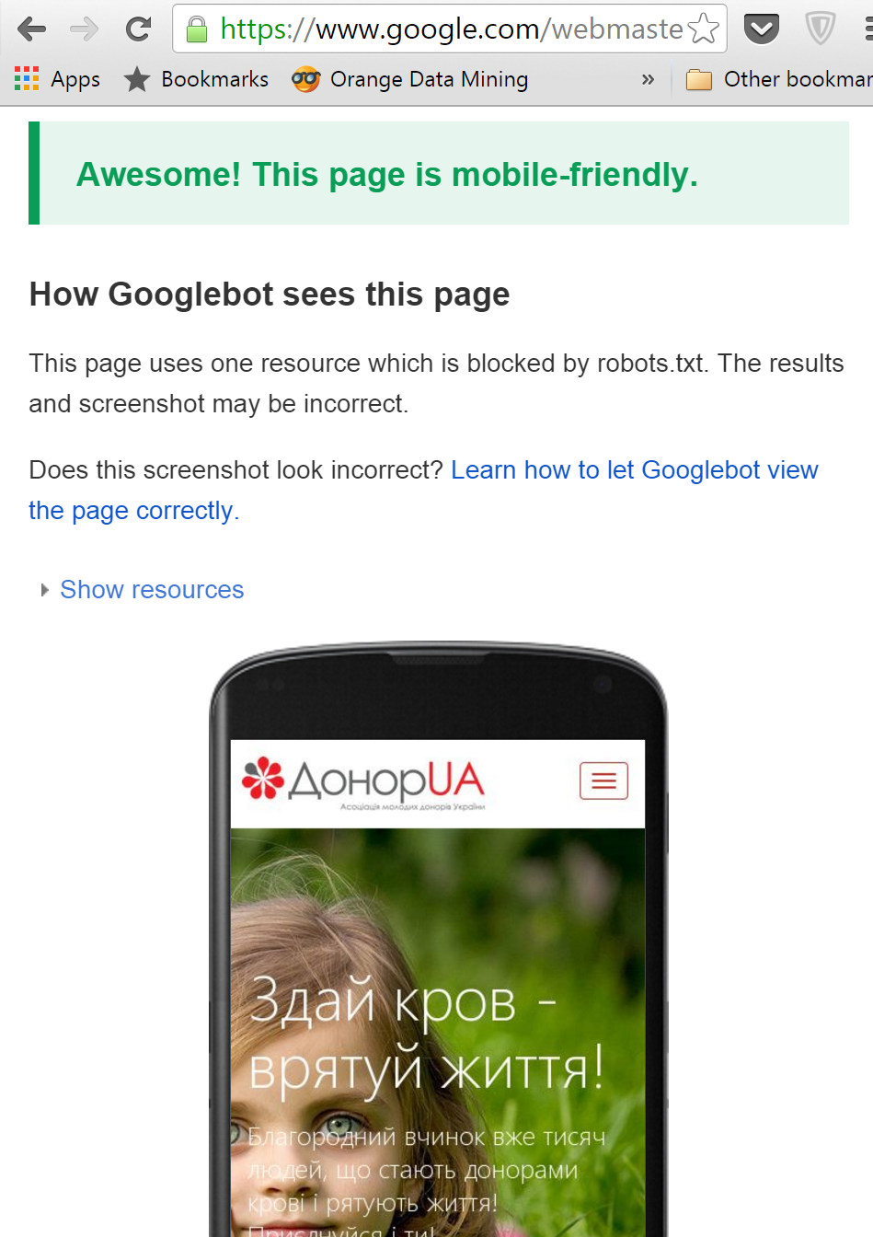
Mobile version
Mobile-Friendly Test https://www.google.com/webmasters/tools/mobile-friendly/

Slide 8
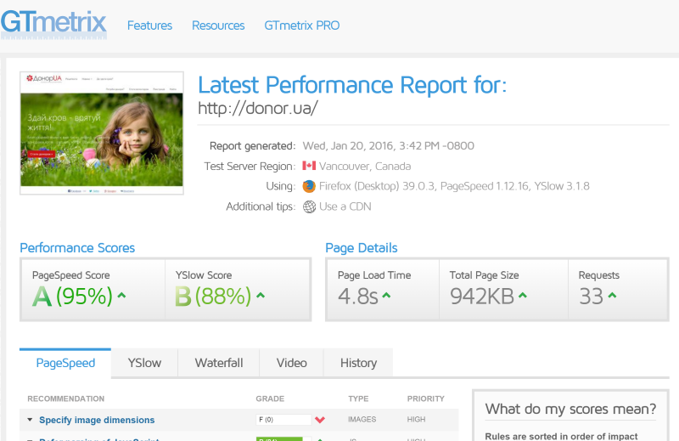
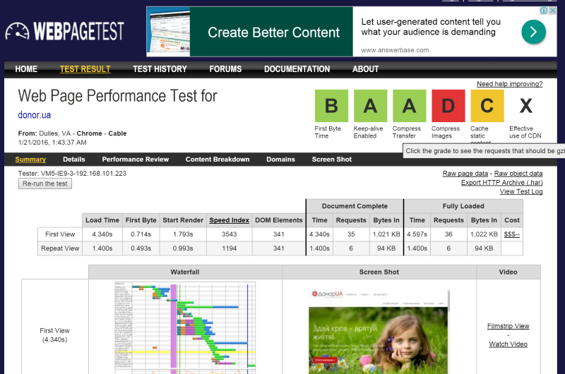
Performance
GTmetrix https://gtmetrix.com/.
http://www.webpagetest.org/
PageSpeed Insights https://developers.google.com/speed/pagespeed/insights/

Slide 9
Social networks integration
Webmasters https://developers.facebook.com/docs/sharing/webmasters
Facebook tools https://developers.facebook.com/tools-and-support/
Twitter Cards Markup https://dev.twitter.com/cards/markup

Slide 10
Security
Automated Security Analyser for ASP.NET Websites https://asafaweb.com/
https://www.qualys.com/
Tracing
Custom errors
Stack trace
HTTP to HTTPs
ELMAH logs
Excessive headers
HTTP only cookies
Secure cookies
Clickjacking

Slide 11
Premier league
Schema.org vocabulary can be used with many different encodings, including RDFa, Microdata and JSON-LD. These vocabularies cover entities, relationships between entities and actions, and can easily be extended through a well-documented extension model. http://schema.org/
Microformats http://microformats.org/
Accessibility https://www.w3.org/standards/webdesign/accessibility
OData - the best way to REST http://www.odata.org/

